Slide 1
The country of my dreams.
Темендерова

Slide 2


Slide 3
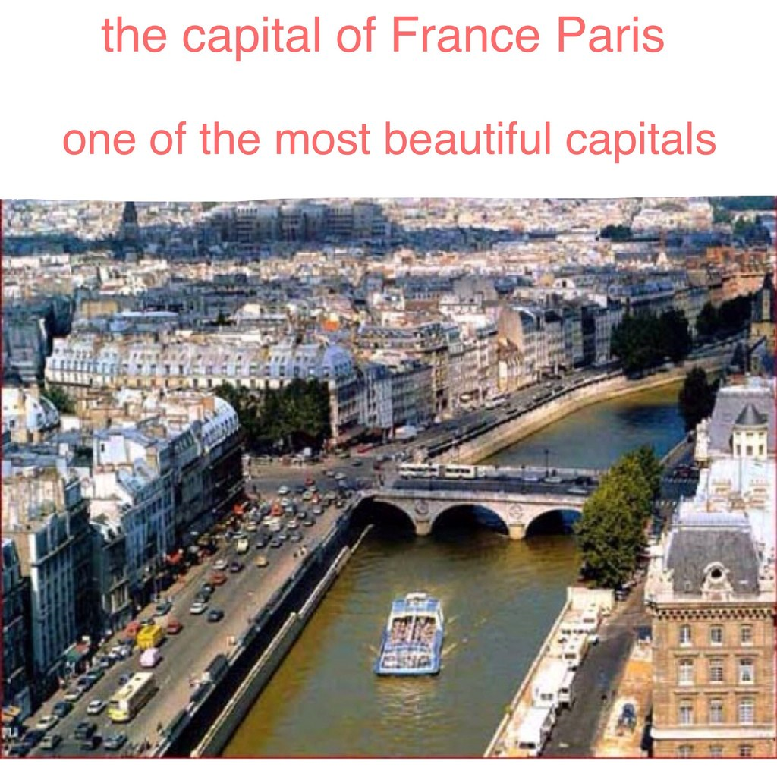

Slide 4
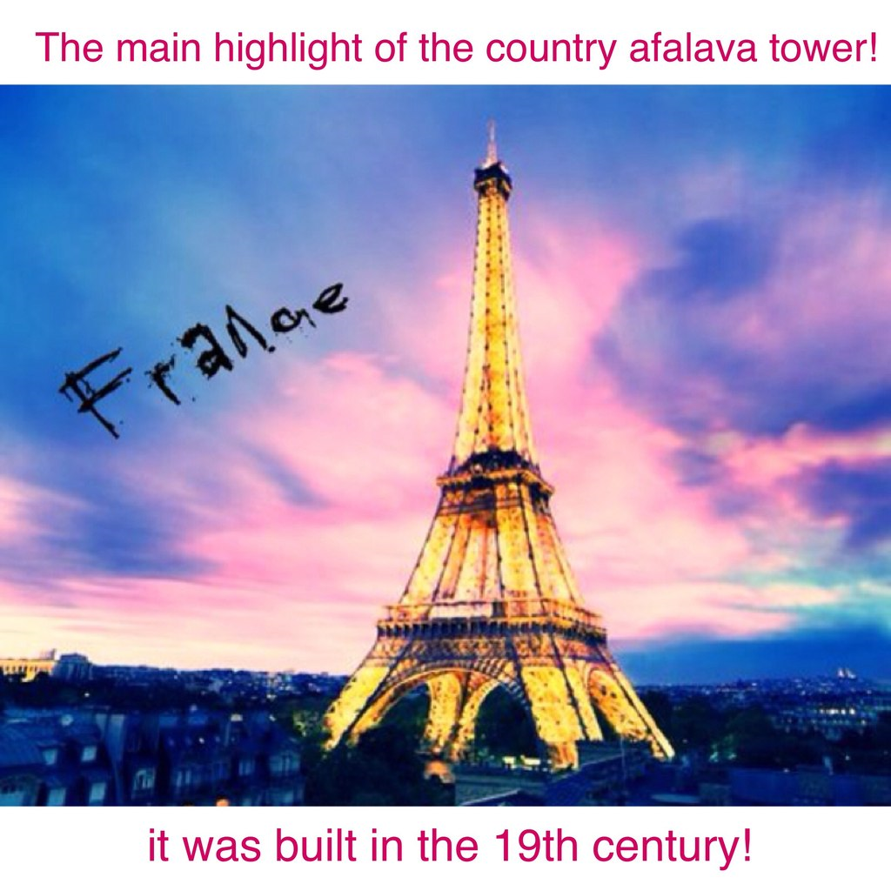

Slide 5
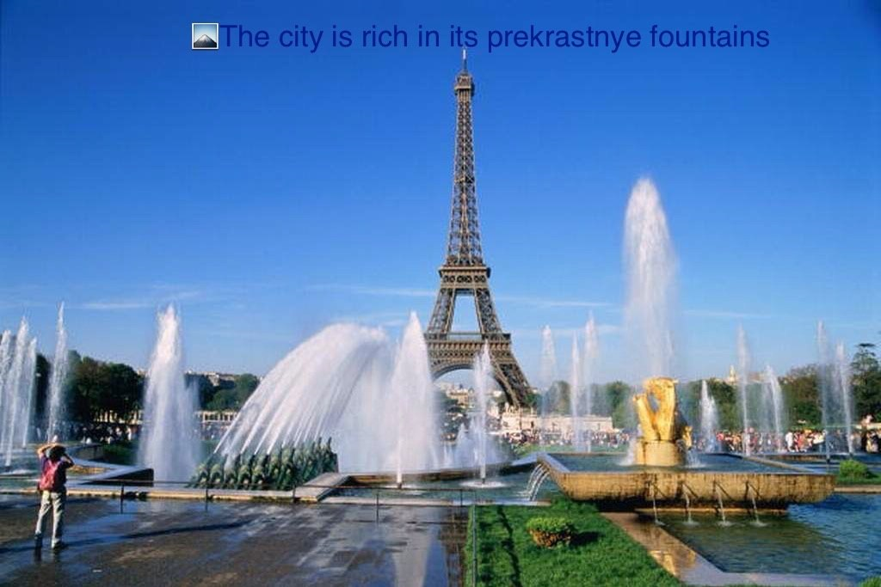

Slide 6


Slide 7


Slide 8
